Slide 1
Income Classification
Dhinesh Kumar S
Ajay S
Logesh R
Guhan M
Kalaiyarasan M

Slide 2
INTRODUCTION
Predicting Income Classifications can be achieved using different classification models, such as decision trees, logistic regression, and random forests. In this presentation, we will
explore the advantages and disadvantages of each model and how they can be used to accurately predict income classifications.

Slide 3
OBJECTIVE
Before building a classification model, it is important to prepare the data. This involves handling missing data,
selecting relevant features, and transforming categorical variables. Proper data preparation can improve
the accuracy of the model.

Slide 4
IMPORTING LIBRARIES
numpy - Numerical computing tool used in Python
matplotlib - Static and interactive visualizations in Python.
seaborn - Statistical data visualization
pandas - Data analysis tool used in Python
scikit-learn - tools for predictive data analysis

Slide 5
IMPORTING DATASET
The dataset contains 15 attributes such as:
age,workclass,fnlwgt,education,education-num,marital-status,occupation,relationship,race,sex,capital-gain,capital-loss,hours-per-week,native-country,income
Therefore,the dataset contains 32561 values.

Slide 6
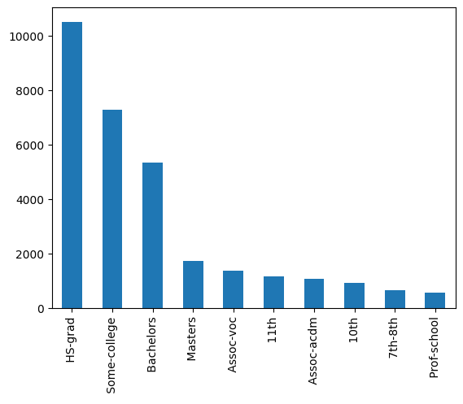
EDA EXPLORATION
Exploratory Data Analysis (EDA) is a statistical approach to analyze and investigate data sets and summarize their main characteristics, often using statistical graphics and other data visualization methods.

Slide 7
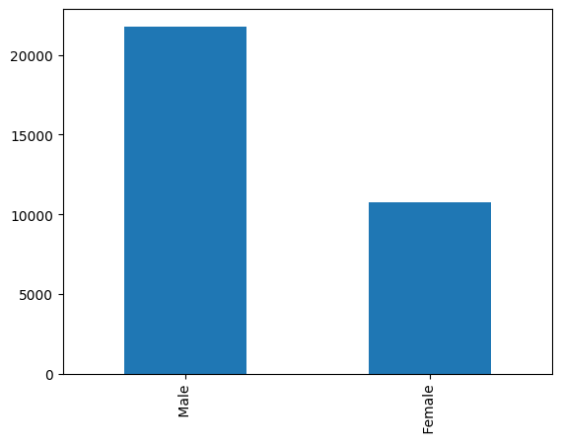
PLOTTING DATA
Plotting the data in bar chart (statistical data visualization).
This figure plots the number of persons that they are male or female.

Slide 8
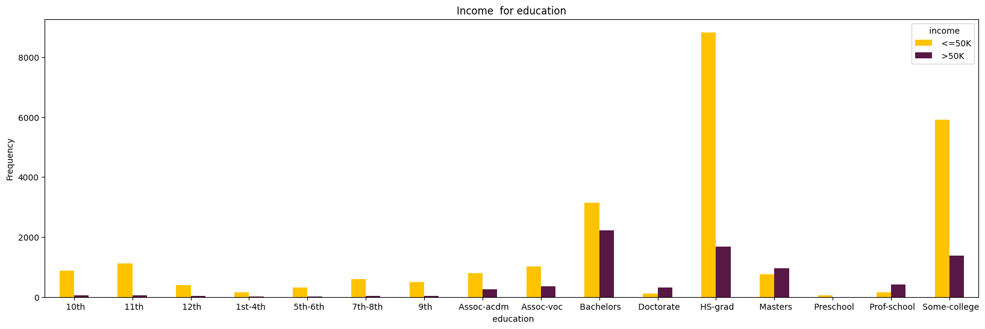
CLASSIFICATION
The income is classified on the basis of the education and the given barchart explains the person with income <=50K person with income >50K

Slide 9
FUNCTIONS
One way to visualize these two metrics is by creating a ROC curve, which stands for “receiver operating characteristic” curve.This is a plot that displays the sensitivity along the y-axis and (1 – specificity) along the x-axis.
One way to quantify how well the logistic regression model does at classifying data is to calculate AUC, which stands for “area under curve.”
The closer the AUC is to 1, the better the model.

Slide 10
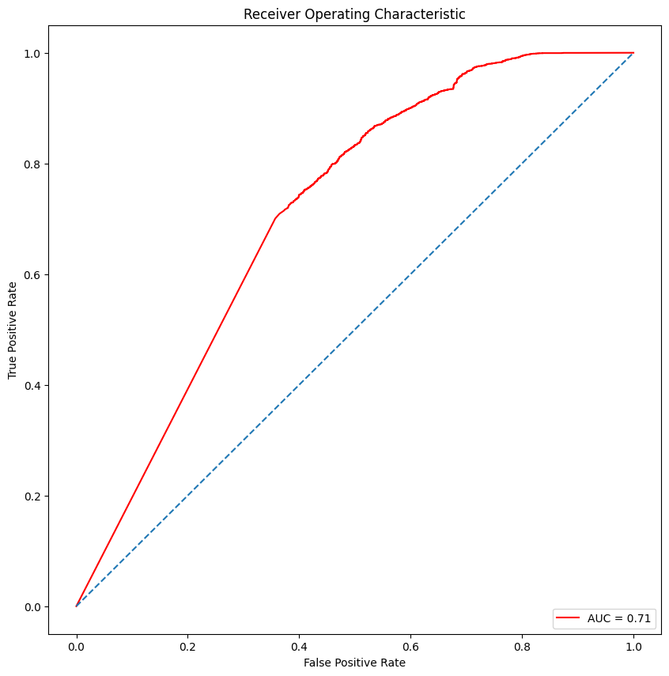
ROC GRAPH
This Graph shows the Receiver Operating Characteristic values and the graph produces the value of
0.7127510438721247
This gives the better model

Slide 11
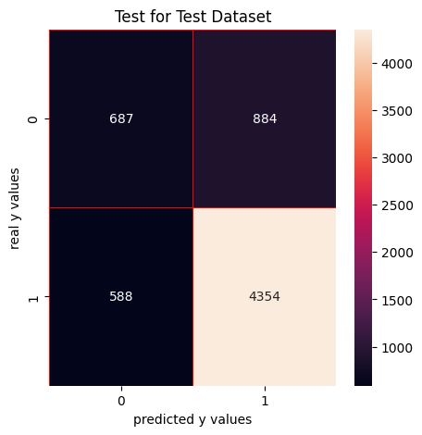
RESULT
Thus the model produces the result more accuracy than other models and the model classifies the income and it is represented the figure.

Slide 12
Thank you!

